Slide 1
Feature Engineering Pipelines in Scikit-Learn & Python
By Ramesh Sampath
Slides: goo.gl/sHC3iw

Slide 2

Ramesh Sampath
Data Science Engineer
Some Machine Learning Models
A lot of Pre-Processing
Deploy it as API Services
@sampathweb (github / twitter / linkedin)

Slide 3
What’s the Problem
Data Scientists Want to -
Build Models
Tune Models
Spend time in Algorithm Land
But Real world data is Messy and spend most of the time in Features Land

Slide 4
Audience
Built some ML Models with Scikit-Learn
Experienced pains of cleaning data
Familiar with Python

Slide 5
Agenda
Data is Messy
Preprocessing Options
End to End Pipeline

Slide 6
Ideal World
Data
Train
Test
fit(X_train, y_train)
score(X_test, y_test)
Build Model
Evaluate Model
Iterate on Algorithm Land
Notes:
One Way

Slide 7
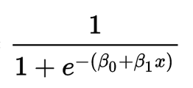
ML is Easy (to get started)
Instantiate the Model. model = LogisticRegression()
Train the Model. model.fit(X_train, y_train)
Evaluate.. model.score(X_test, y_test) / model.predict(X_test)
One Gotta -
Data needs to be Numerical Vector for Matrix Manipulation.

Slide 8
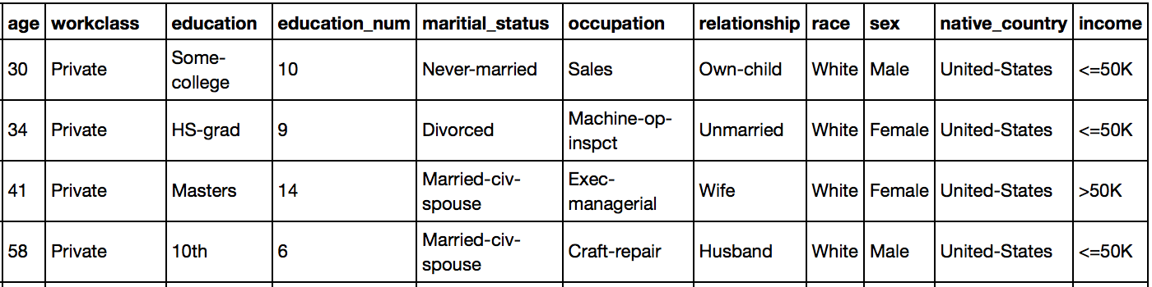
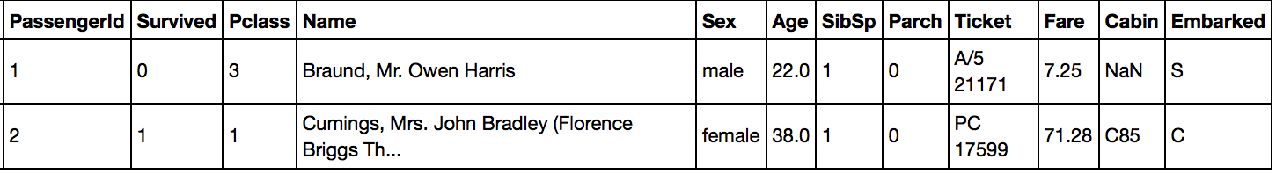
Data is Messy

Slide 9
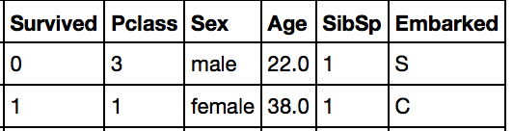
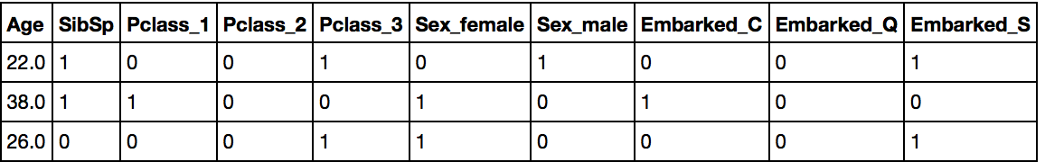
Vectorizing
Target -
Classification
Class - Categorical
Gender - Categorical
Age - Continuous, N/A
Sibling -
Count
Embarked - Categorical, N/A
Logistic Regression
Notes:
One Way

Slide 10
Data Pipeline
Data
Train
Test
Clean Data
Impute Columns
Vectorize into Numerical Features
Extract Additional Features
fit(X_train, y_train)
Build Model
Pipeline
Notes:
One Way

Slide 11
Train
Test
Pclass, Sex, Embarked -
Dummy values
Age, Fare -
Impute Missing values
Standardize to zero mean
SibSp, Parch -
No tranformation
Feature Union
Build Model
fit(X_train, y_train)
Pipeline
Notes:
One Way

Slide 12
Preprocessing
Column | Transformation Required | Scikit-Learn Methods
Pclass | Convert 1, 2, 3 to three columns | OneHotEncoder
Sex | Convert Male / Female to Binary | LabelBinarizer
Age | Impute Null Values Zero Mean | Imputer StandardScalar
SibSp | Counts. No Pre-processing Required
Embarked | Impute Null Values (most common) Encode Embarked Stations to OneHot 1/0 values | Custom Imputer LabelBinarizer (LabelEncoder & OneHotEncoder)

Slide 13
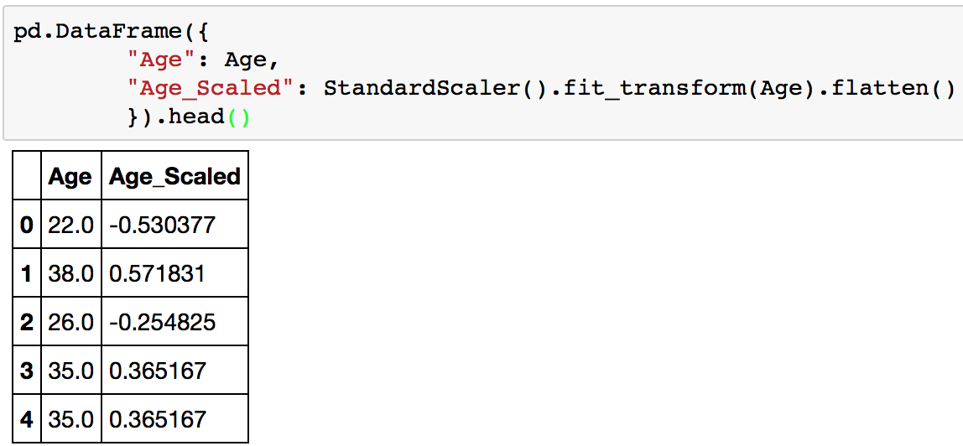
StandardScaler
Zero Mean
Unit STD
Other Scalers - Min-Max Scaler, Normalizer.

Slide 14
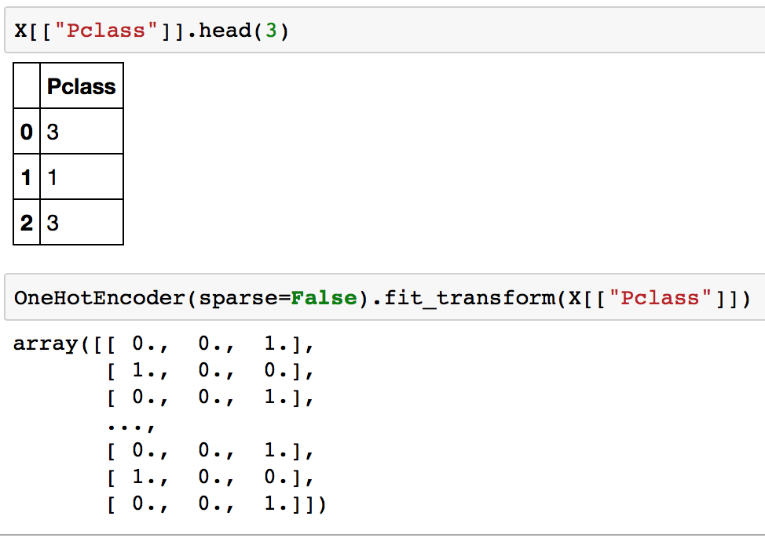
OneHotEncoder
Transform Pclass

Slide 15
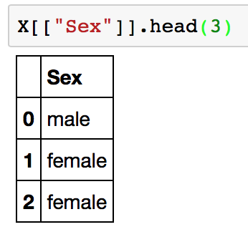
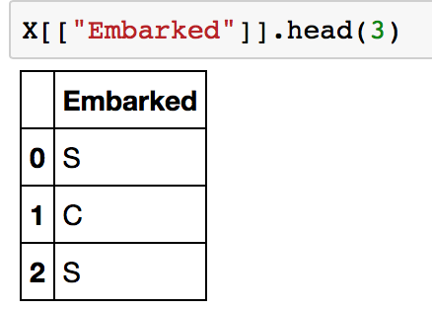
Categorical Variables
OneHotEncoder Doesn’t work with Categorical Data :-(

Slide 16
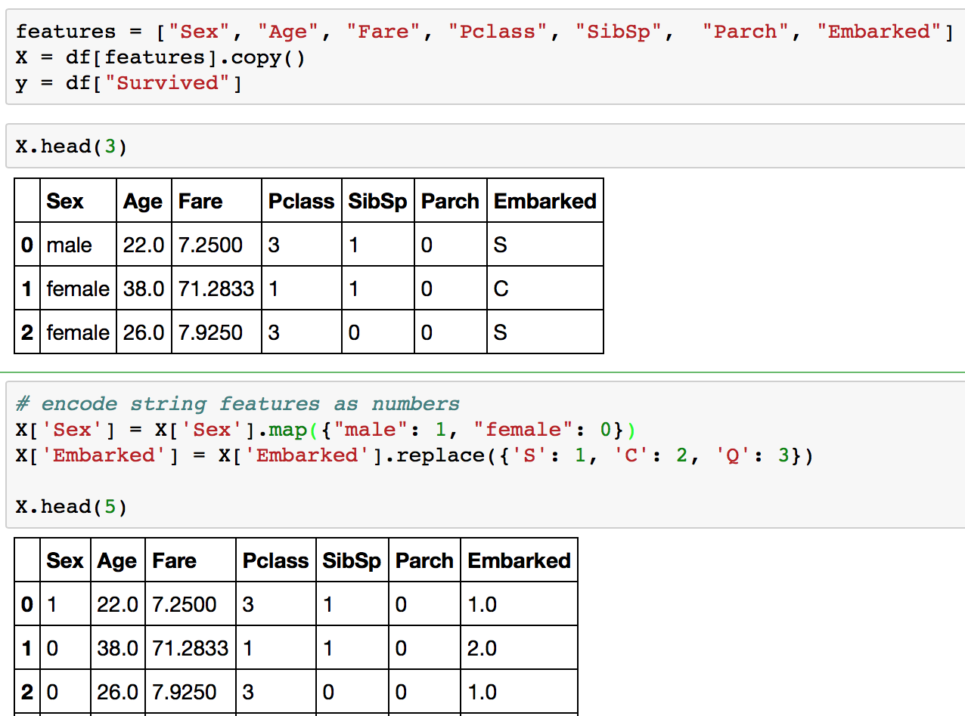
OneHotEncoder
Map Strings to Numeric

Slide 17
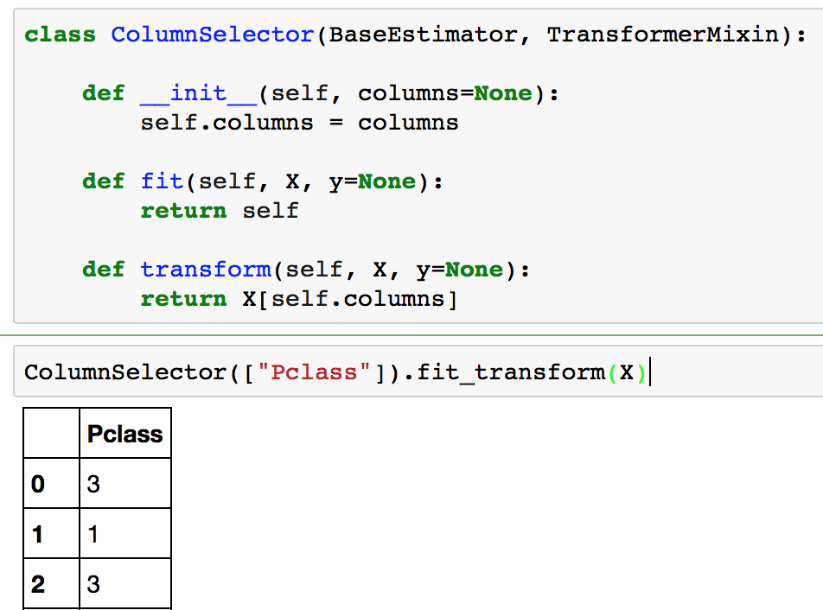
Column Selector

Slide 18
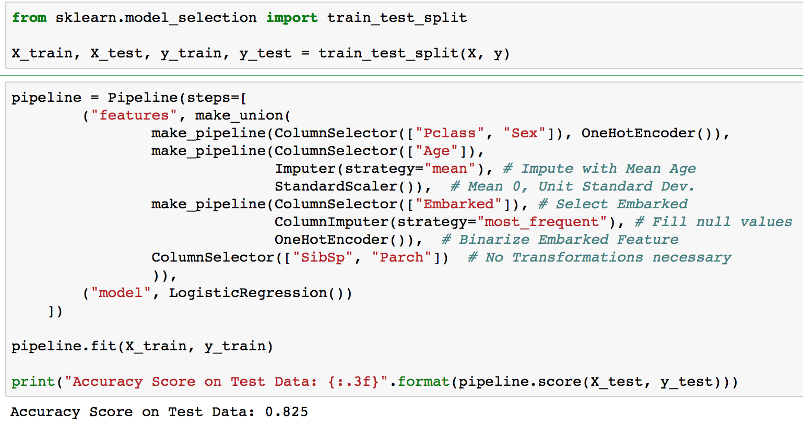
Pipeline

Slide 19
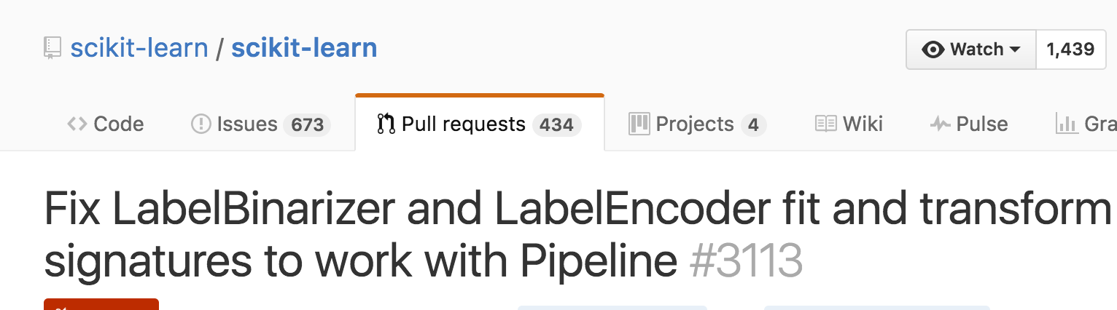
One Problem
Convert ALL Categorical Columns to Numeric before OneHotEncoder
Fix in next Scikit-Learn version 0.19 (issue # 7327)
Categorical Encoders -
DictVectorizer
Label Encoder + OneHotEncoder
Label Binarizer

Slide 20
Alternatives
Preprocess in Pandas and convert to Numeric
Create our own Custom Transformers
Use SKLearn-Pandas
Original code by Ben Hamner (Kaggle CTO) and
Paul Butler (Google NY) 2013
Recent Version 1.2, Oct'2016

Slide 21
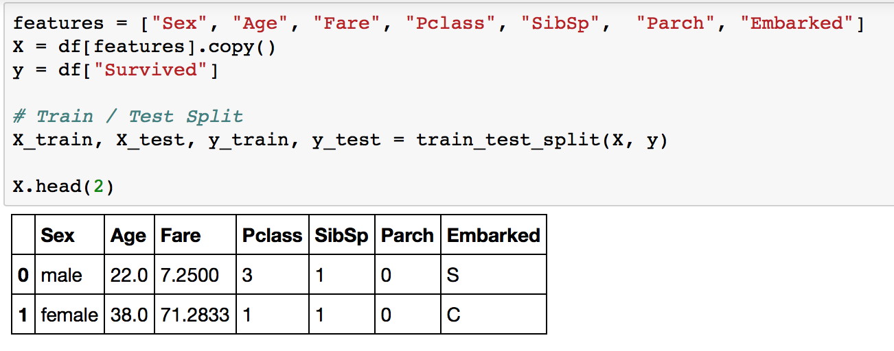
SKLearn-Pandas

Slide 22
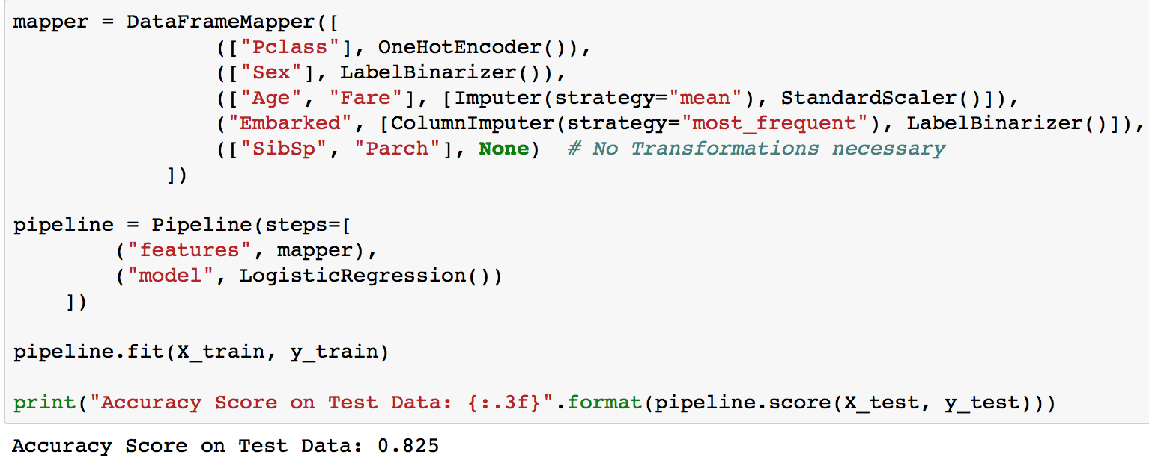
SKLearn-Pandas

Slide 23
Feature Engineering Pipeline
Pre-Processing
Cleaning / Imputing Values
Encoding to Numerical Vectors
Feature Extractions
Text Vectorization (Count / TFIDF)
Polynomial Features
Feature Reduction & Selection
PCA
SelectFromModel
Machine Learning Models
Grid Search - Hyper Parameter Tuning of Models

Slide 24
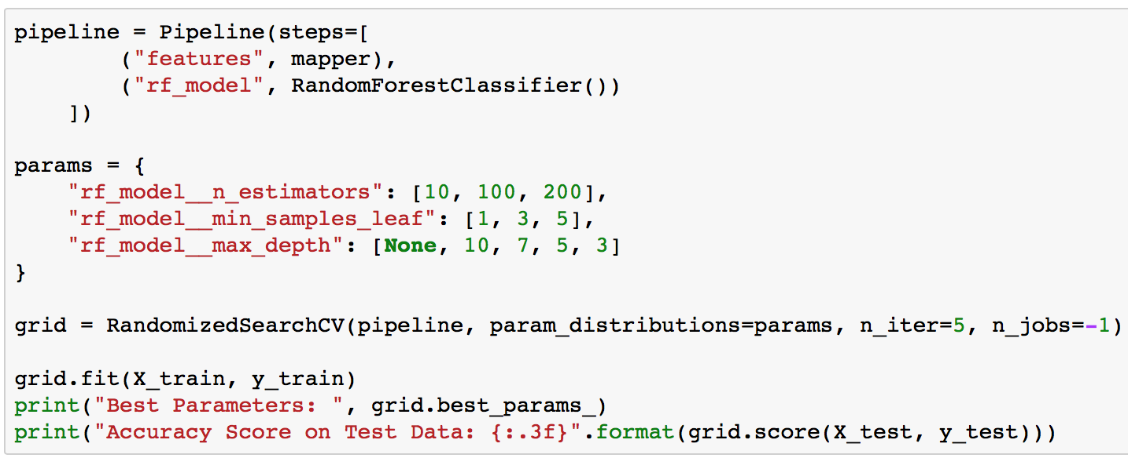
Grid Search
Hyper Parameter Tuning (Hurry!)
Back in Algorithm Land

Slide 25
Jupyter Notebook
https://github.com/sampathweb/odsc-feature-engineering-talk

Slide 26
Credits
Scikit-Learn (https://github.com/scikit-learn/scikit-learn)
Sklearn-Pandas (https://github.com/paulgb/sklearn-pandas)
StackOverflow Posts:
http://stackoverflow.com/questions/24458645/label-encoding-across-multiple-columns-in-scikit-learn
http://stackoverflow.com/questions/34710281/use-featureunion-in-scikit-learn-to-combine-two-pandas-columns-for-tfidf

Slide 27
Thank You!
Slides: https://goo.gl/sHC3iw
@sampathweb (Github / Twitter / Linkedin)

